Slide 1
Domestic Electricity Usage Prediction

Slide 2
Project Overview

Slide 3
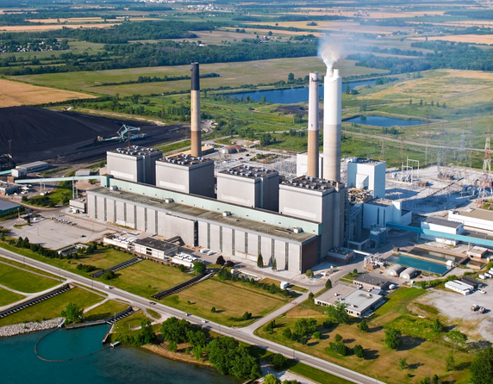
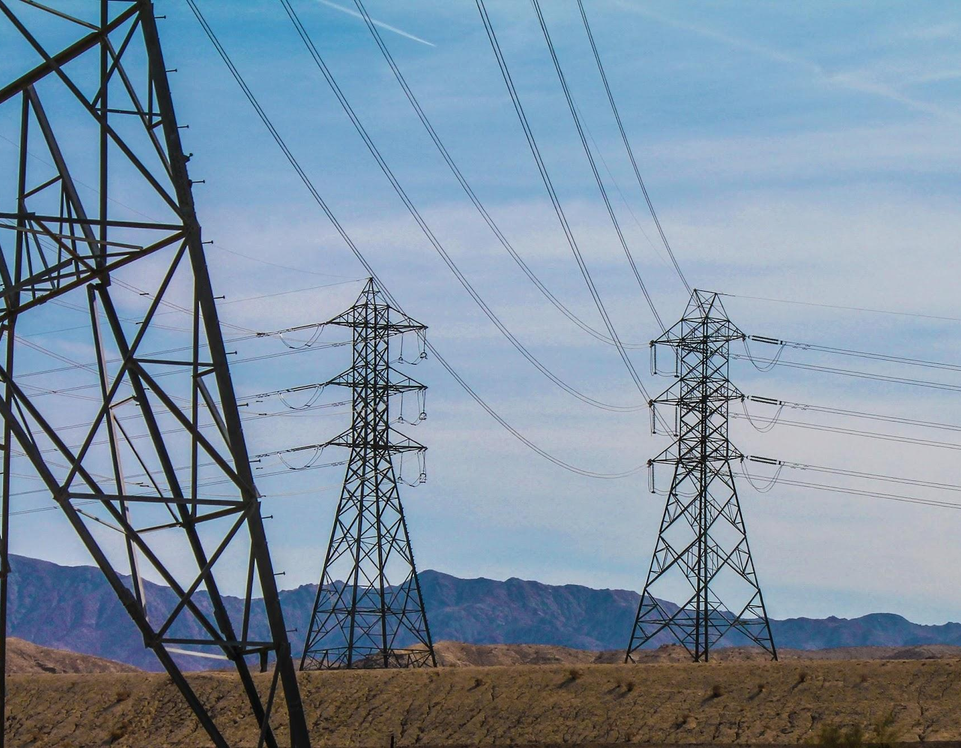
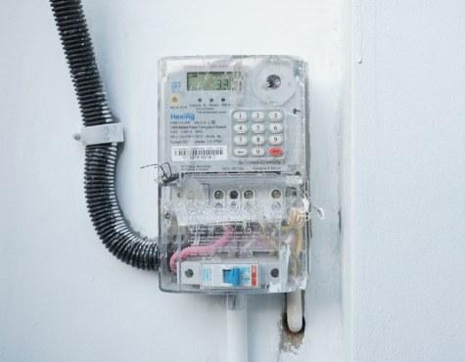
Electricity Business Process
Electricity Metering
Measures electricity usage. Currently in Indonesia, remote monitoring is unavailable.
Unlawful consumer can tamper the meter so they pay less money for more electricity illegally.
Generation
Generates electricity by transmission’s (and distribution’s) request.
Transmission & Distribution
Distributes electricity from generators to consumers.
The amount of electricity required / requested is also known as “load”

Slide 4
Goal & Question:
Goal:
Seek insight from a domestic electricity usage data and weather data so load forecasting and illegal usage detection can be done.
Question:
How weather affects electricity usage at home?
Can we predict consumer electricity usage accurately using available weather data?

Slide 5
Data Understanding

Slide 6
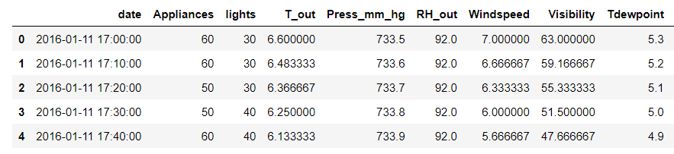
Data Understanding
The data is acquired from a paper. Electricity usage is measured every 10 minutes. Weather data is acquired from Reliable Prognosis (rp5.ru). Some weather data are interpolated.
Source: https://archive.ics.uci.edu/ml/datasets/Appliances+energy+prediction

Slide 7
Features
Column Name | Description
date | Timestamp
Appliances | Electricity usage in Wh (target)
lights | Light fitting electricity usage in Wh
T_Out | Outside temperature
Press_mm_hg | Outside Air pressure

Slide 8
Features
Column Name | Description
RH_out | Outside humidity
Windspeed | Self explanatory
Visibility | Visibility in km
Tdewpoint | Dewpoint temperature

Slide 9
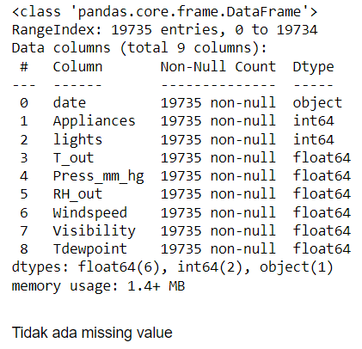
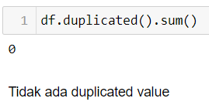
Data Cleaning
No duplicates nor missing values

Slide 10
Exploratory Data Analysis

Slide 11
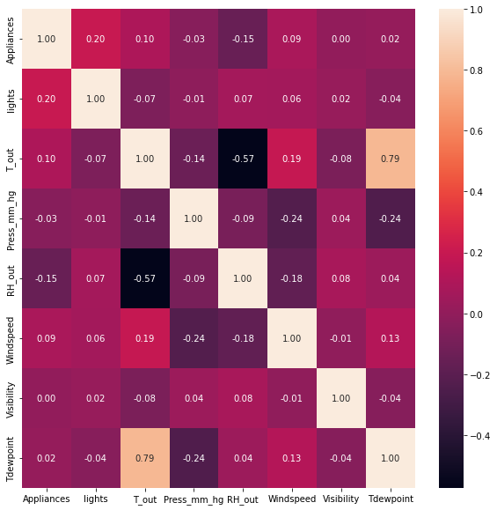
Correlation Heat Map
No feature is having high correlation with target variable (Appliances)
Highest correlation (0.2) is lights
Highest negative correlation is humidity (RH_out)

Slide 12
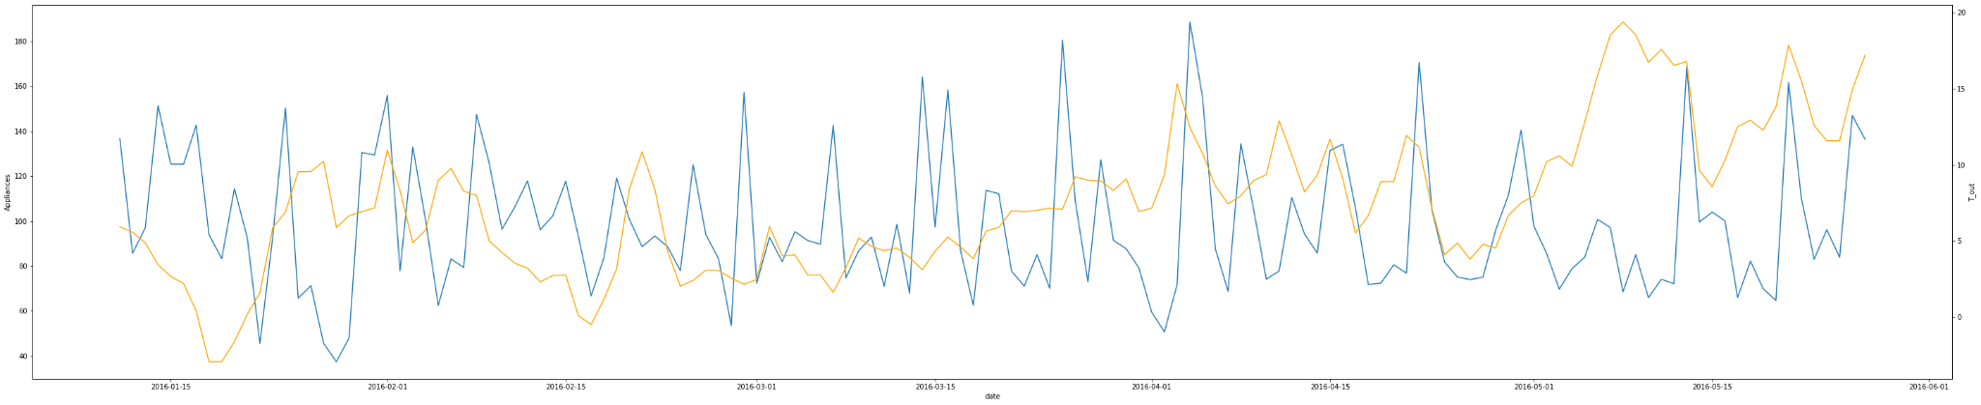
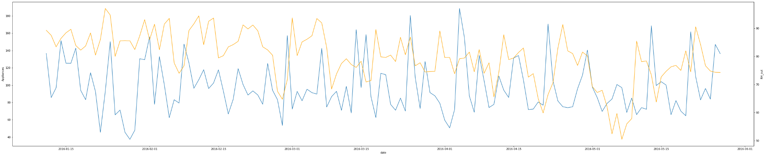
Time Series Lineplot
No apparent correlation between temperature and electricity usage, or humidity and electricity usage
T_out
RH_out

Slide 13
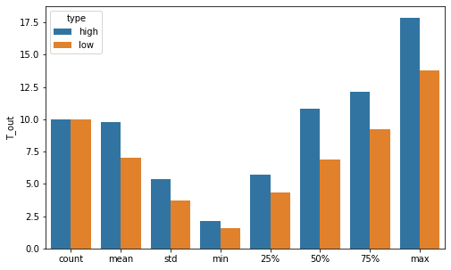
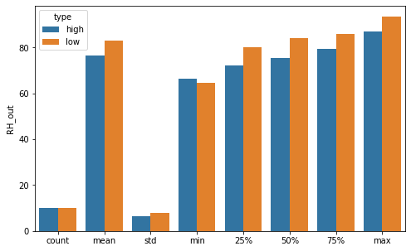
10 Hari Penggunaan Tertinggi dan Terendah
Interestingly, 10 days with highest electricity usage have more average temperature and less average humidity than 10 days with lowest electricity usage

Slide 14
Machine Learning Modelling

Slide 15
Base Model
Model | RMSE | MAE | MAPE
Linear Regression (Train Data) | 97.6 | 55.83 | 65.7%
Linear Regression (Test Data | 103.6 | 57.7 | 65.6%
Random Forest (Train Data) | 27.3 | 13.6 | 14.7%
Random Forest (Test Data) | 76.8 | 37.9 | 38.7%
KNN (Train Data) | 68.45 | 33.68 | 34.6%
KNN (Test Data) | 76.8 | 37.9 | 38.7%
There is an indication of overfitting. Shown by higher performance on training data, but not testing data. Even after using a simpler model (KNN) the result is not any better.

Slide 16
Tuned Hyperparameter
Model | RMSE | MAE | MAPE
Random Forest (Train Data) | 26.7 | 13.47 | 14.5%
Random Forest (Test Data) | 76.8 | 37.8 | 38.4%
KNN (Test Data) | 89.4 | 41.0 | 38.9%
After hyperparameter tuning, there’s no significant change in the model performance.

Slide 17
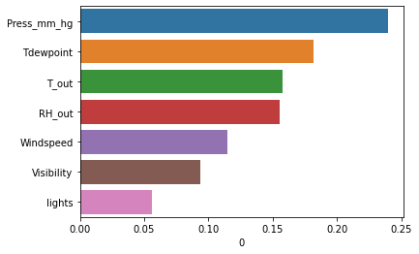
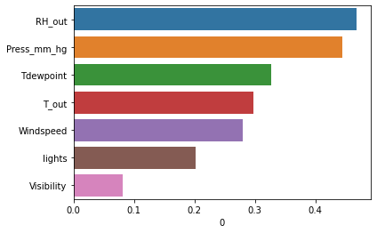
Feature Importance
Analyzing feature importance on the random forest model yield a similar result from EDA.
T_out and RH_out is considered important by the model hence emphasizing the EDA result.

Slide 18
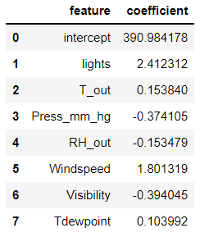
Linear Regression (Data Harian)
Model | RMSE | MAE | MAPE
Linear Regression (Train Data) | 28.5 | 22.70 | 24.3%
Linear Regression (Test Data | 30.8 | 25.7 | 30.1%
Building a linear regression model using averaged daily data yield a better performing model.
Yet it is possible for it to perform better due to less data being tested against it.
Model interpretation yield different result from previous analysis on feature importance but similar to correlation analysis that lights is the most correlated feature.

Slide 19
Conclusion
Weather conditions such as temperature, humidity, and air pressure affects electricity usage.
The built model is having at best 38% error or 62% accuracy meaning the model can’t be used for predicting domestic electricity usage.
There is an indication of overfitting in the model.

Slide 20
Recommendation
Electrical utility company can prepare a higher electricity supply when the temperature is higher and humidity is lower, or vice versa.
Electrical utility company may consider changes in temperature and air pressure while doing analysis to detect illegal usage on the consumer’s usage
The model requires more development until it can be used to predict electricity usage accurately.

